Slide 1










ATAI
Advanced Technique of Artificial Intelligence
ATAI
ChongqingUniversity _{AdvancedTechniqueof}
of Technology Artificial Intelligence
Chongqing University of
Technology
Chongqing University ^{ATAI}
_{of Technology} Advanced Techniqueof
Artificial Intelligence
Chongqing University of Technology
Chongqing University of Technology
GNN-RAG: Graph Neural Retrieval for Efficient Large Language Model
Reasoning on Knowledge Graphs
Code:https://github.com/cmavro/GNN-RAG
——ACL 2025
Reported by Xiang Zhang
1

Slide 2
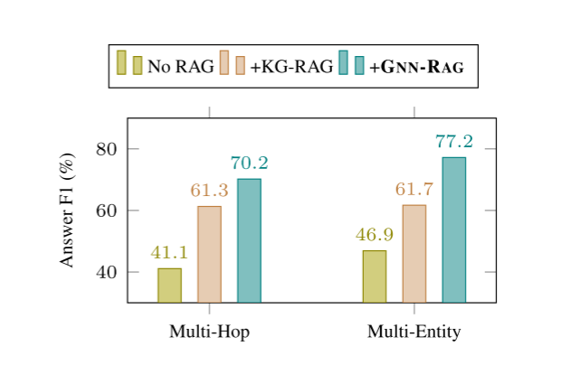
ATAI
Advanced Technique of Artificial Intelligence
ATAI
ChongqingUniversity _{AdvancedTechniqueof}
of Technology Artificial Intelligence
Chongqing University of
Technology
Chongqing University ^{ATAI}
_{of Technology} Advanced Techniqueof
Artificial Intelligence
Chongqing University of Technology
Chongqing University of Technology
Motivation
Most recent approaches rely on costly LLM calls to generate executable relation paths or traverse the KG, which is inefficient in complex KGQA tasks, such as those involving multi-hop or multi-entity questions.We introduce the GNN-RAG framework, which utilizes lightweight Graph Neural Networks (GNNs) for effective and efficient graph retrieval.

Slide 3
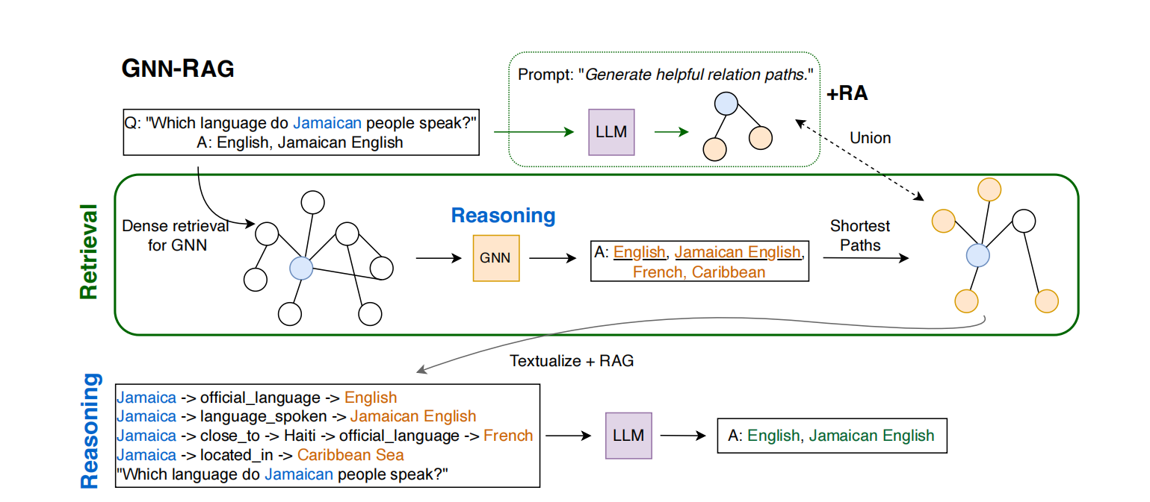
ATAI
Advanced Technique of Artificial Intelligence
ATAI
ChongqingUniversity _{AdvancedTechniqueof}
of Technology Artificial Intelligence
Chongqing University of
Technology
Chongqing University ^{ATAI}
_{of Technology} Advanced Techniqueof
Artificial Intelligence
Chongqing University of Technology
Chongqing University of Technology
Overview

Slide 4
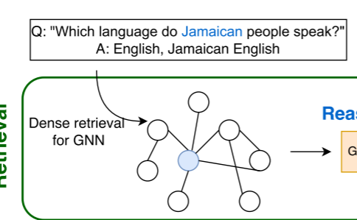
ATAI
Advanced Technique of Artificial Intelligence
ATAI
ChongqingUniversity _{AdvancedTechniqueof}
of Technology Artificial Intelligence
Chongqing University of
Technology
Chongqing University ^{ATAI}
_{of Technology} Advanced Techniqueof
Artificial Intelligence
Chongqing University of Technology
Chongqing University of Technology
Method
As KGs usually contain millions of facts and nodes, a smaller question-specific subgraph Gq is retrieved for a question q. Entity linking identifies question entities {eq} and subgraph Gq is extracted by following connections that start from
these question entities.

Slide 5
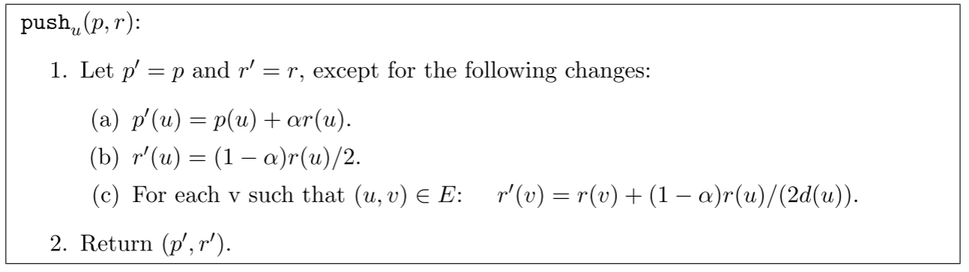
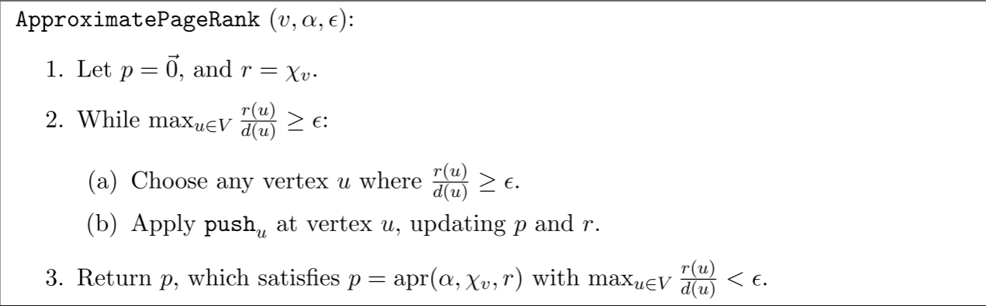
ATAI
Advanced Technique of Artificial Intelligence
ATAI
ChongqingUniversity _{AdvancedTechniqueof}
of Technology Artificial Intelligence
Chongqing University of
Technology
Chongqing University ^{ATAI}
_{of Technology} Advanced Techniqueof
Artificial Intelligence
Chongqing University of Technology
Chongqing University of Technology
Method

Slide 6
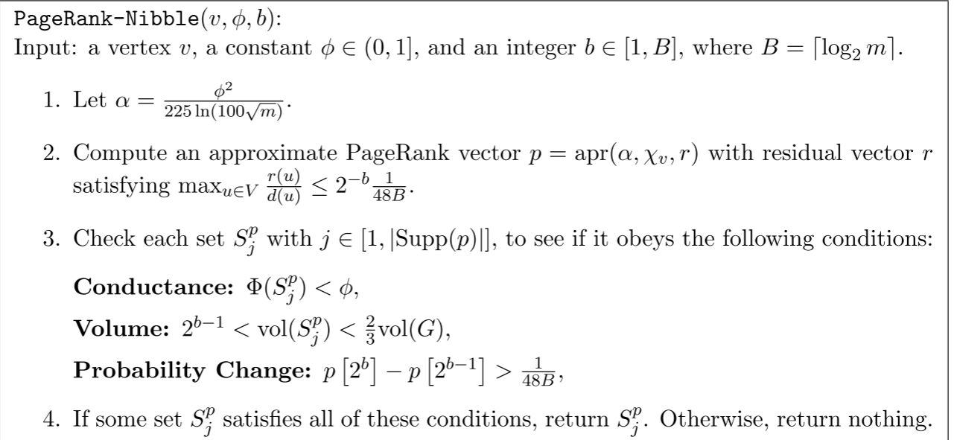
ATAI
Advanced Technique of Artificial Intelligence
ATAI
ChongqingUniversity _{AdvancedTechniqueof}
of Technology Artificial Intelligence
Chongqing University of
Technology
Chongqing University ^{ATAI}
_{of Technology} Advanced Techniqueof
Artificial Intelligence
Chongqing University of Technology
Chongqing University of Technology
Method

Slide 7

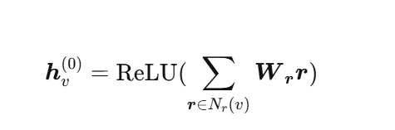
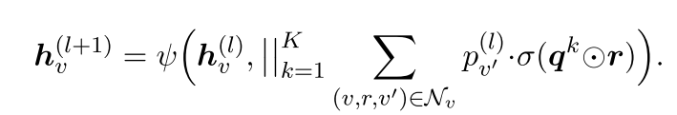

ATAI
Advanced Technique of Artificial Intelligence
ATAI
ChongqingUniversity _{AdvancedTechniqueof}
of Technology Artificial Intelligence
Chongqing University of
Technology
Chongqing University ^{ATAI}
_{of Technology} Advanced Techniqueof
Artificial Intelligence
Chongqing University of Technology
Chongqing University of Technology
Method
As complex questions consist of multiple subquestions, we obtain K different question embeddings qk, that capture different question parts . Question embeddings qk and KG relation embeddings r are encoded via a shared pretrained LM , such as SBERT .
We implement a multi-head GNN layer which aggregates neighboring messages based on different question parts as

Slide 8
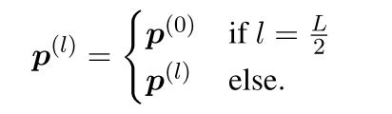
ATAI
Advanced Technique of Artificial Intelligence
ATAI
ChongqingUniversity _{AdvancedTechniqueof}
of Technology Artificial Intelligence
Chongqing University of
Technology
Chongqing University ^{ATAI}
_{of Technology} Advanced Techniqueof
Artificial Intelligence
Chongqing University of Technology
Chongqing University of Technology
Method
This approach ensures that node embeddings capture deep graph information, enabling a revisited and refined KG traversal.

Slide 9
ATAI
Advanced Technique of Artificial Intelligence
ATAI
ChongqingUniversity _{AdvancedTechniqueof}
of Technology Artificial Intelligence
Chongqing University of
Technology
Chongqing University ^{ATAI}
_{of Technology} Advanced Techniqueof
Artificial Intelligence
Chongqing University of Technology
Chongqing University of Technology
Method
Treating KGQA as a node classification problem, where the correct answer nodes are positive samples and other nodes are negative samples, the GNN is trained such that the probability of the correct answer nodes approaches 1 in the final layer, and the GNN parameters are optimized using the KL divergence loss.
During inference, nodes with the highest probability scores are identified as candidate answers. To filter out noisy information, we select nodes whose cumulative probability exceeds a threshold of 0.95.Subsequently, the shortest paths connecting the question entities to the candidate answers are extracted. These reasoning paths are then verbalized using a predefined template and serve as input for the LLM-based RAG process.

Slide 10
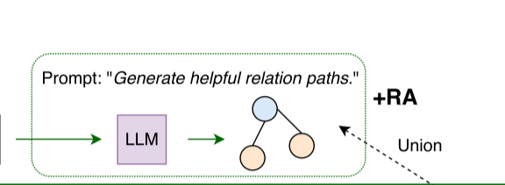
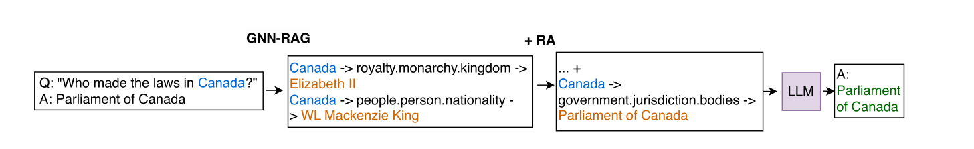
ATAI
Advanced Technique of Artificial Intelligence
ATAI
ChongqingUniversity _{AdvancedTechniqueof}
of Technology Artificial Intelligence
Chongqing University of
Technology
Chongqing University ^{ATAI}
_{of Technology} Advanced Techniqueof
Artificial Intelligence
Chongqing University of Technology
Chongqing University of Technology
Method
We use RoG as the semantic parsing approach, which finetunes a 7B LLM to generate executable relation paths given a question. During inference, we take the union of the reasoning paths retrieved by the two retrievers.

Slide 11
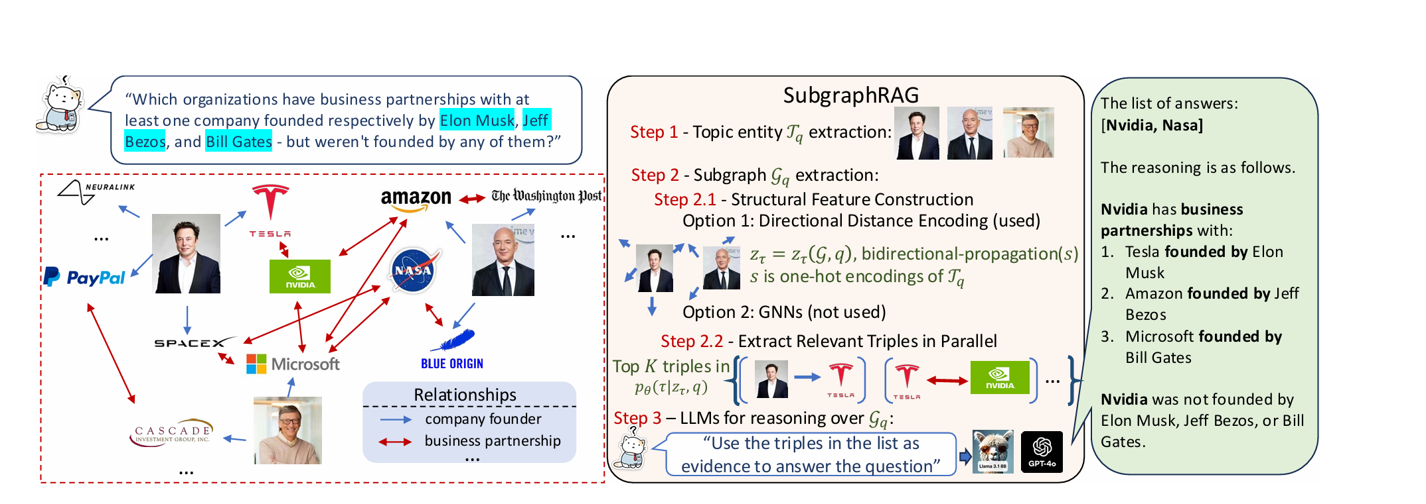
ATAI
Advanced Technique of Artificial Intelligence
ATAI
ChongqingUniversity _{AdvancedTechniqueof}
of Technology Artificial Intelligence
Chongqing University of
Technology
Chongqing University ^{ATAI}
_{of Technology} Advanced Techniqueof
Artificial Intelligence
Chongqing University of Technology
Chongqing University of Technology
Method
Specifically, the context retrieved by GNN-RAG is fed into the downstream LLM to generate answers. If any of the generated responses are not included in the long-context, e.g., in the top-k = 100 triplets retrieved by text similarity, this indicates that GNN-RAG has provided additional deep graph context that is beneficial for answering the question. In contrast, when the answers align with the long-context information, the system routes the inference to long-context processing, thereby capitalizing on the increased graph data.

Slide 12
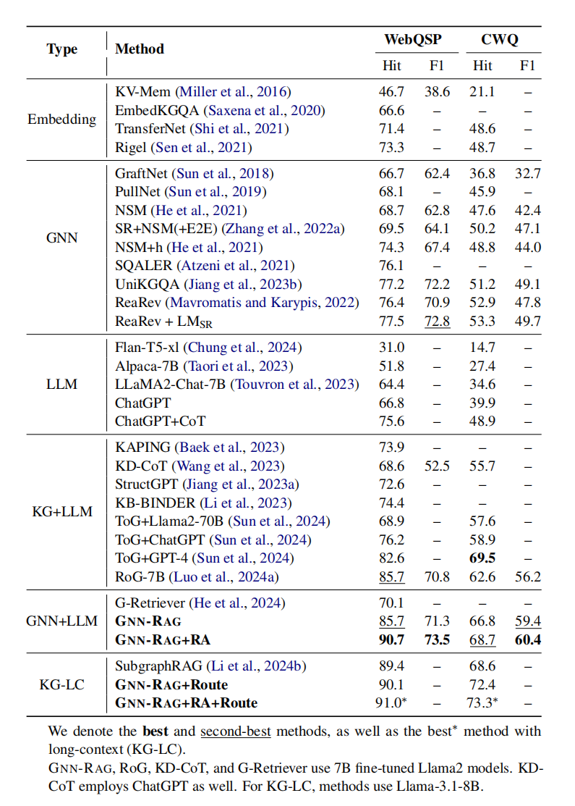
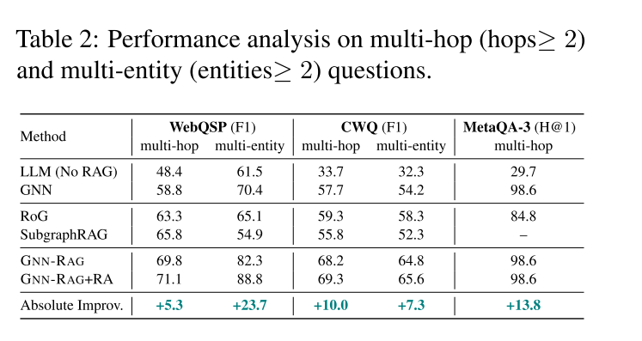
ATAI
Advanced Technique of Artificial Intelligence
ATAI
ChongqingUniversity _{AdvancedTechniqueof}
of Technology Artificial Intelligence
Chongqing University of
Technology
Chongqing University ^{ATAI}
_{of Technology} Advanced Techniqueof
Artificial Intelligence
Chongqing University of Technology
Chongqing University of Technology
Experiments

Slide 13
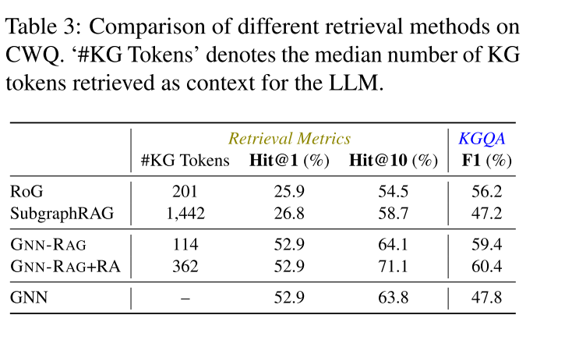
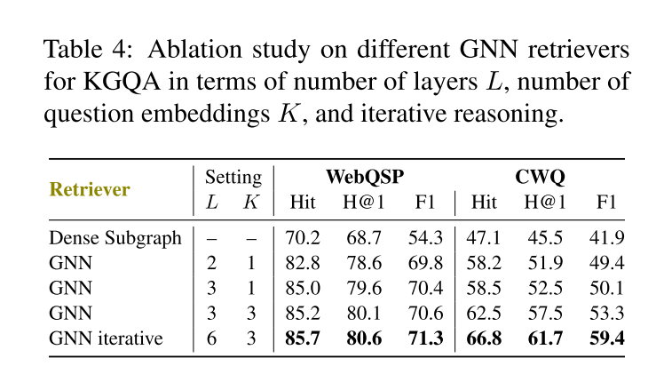
ATAI
Advanced Technique of Artificial Intelligence
ATAI
ChongqingUniversity _{AdvancedTechniqueof}
of Technology Artificial Intelligence
Chongqing University of
Technology
Chongqing University ^{ATAI}
_{of Technology} Advanced Techniqueof
Artificial Intelligence
Chongqing University of Technology
Chongqing University of Technology
Experiments

Slide 14
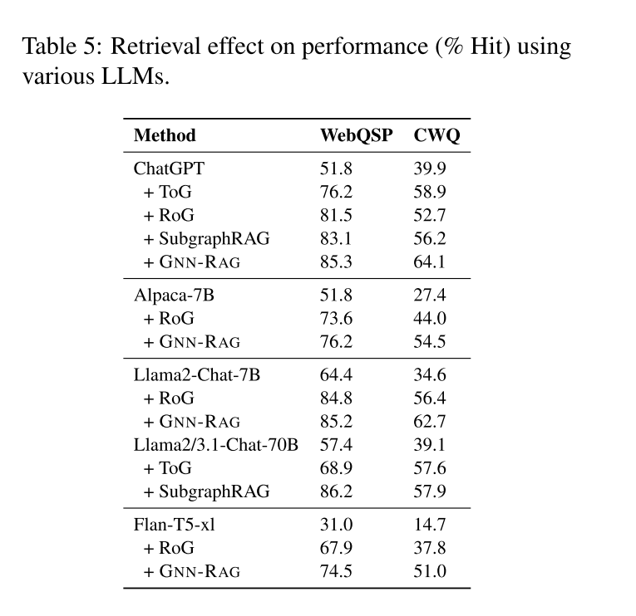
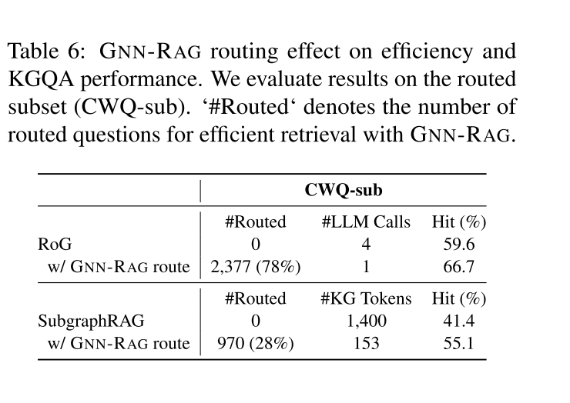
ATAI
Advanced Technique of Artificial Intelligence
ATAI
ChongqingUniversity _{AdvancedTechniqueof}
of Technology Artificial Intelligence
Chongqing University of
Technology
Chongqing University ^{ATAI}
_{of Technology} Advanced Techniqueof
Artificial Intelligence
Chongqing University of Technology
Chongqing University of Technology
Experiments

Slide 15
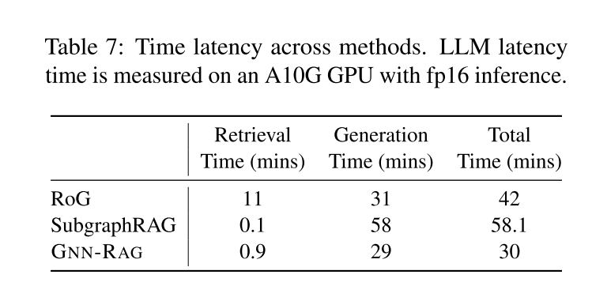
ATAI
Advanced Technique of Artificial Intelligence
ATAI
ChongqingUniversity _{AdvancedTechniqueof}
of Technology Artificial Intelligence
Chongqing University of
Technology
Chongqing University ^{ATAI}
_{of Technology} Advanced Techniqueof
Artificial Intelligence
Chongqing University of Technology
Chongqing University of Technology
Experiments

Slide 16


ATAI
Advanced Technique of Artificial Intelligence
ATAI
ChongqingUniversity _{AdvancedTechniqueof}
of Technology Artificial Intelligence
Chongqing University of
Technology
Chongqing University ^{ATAI}
_{of Technology} Advanced Techniqueof
Artificial Intelligence
Chongqing University of Technology
Chongqing University of Technology
Thanks!

